Slide 1

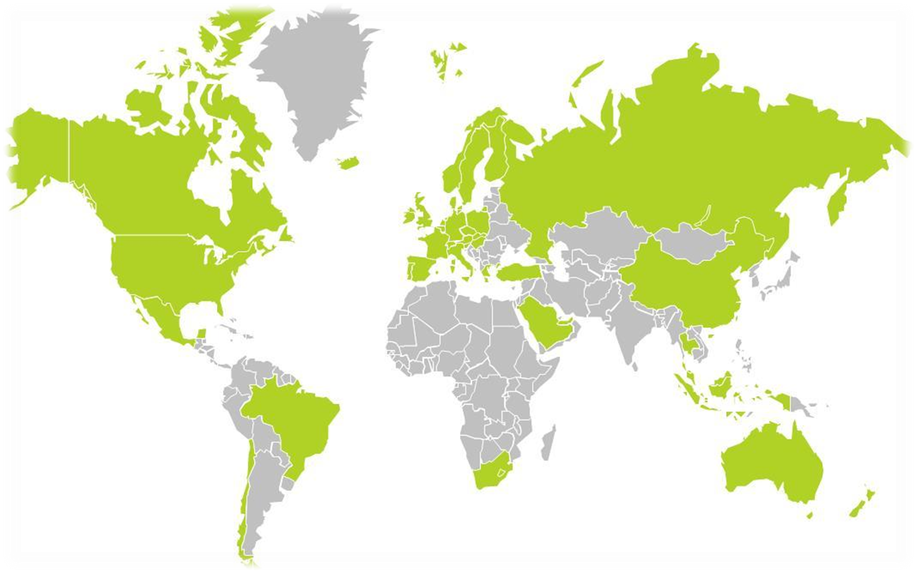



Slide 2
Geospatial Vision & Visualization
ASSIGNMENT # 2
Submitted by:
      Abhay Nagaraj B R (A20382006)
      Ravikiran Puttaraju (A20387024)
      Puneeth Bondugala Reddy (A20379964)

Slide 3

Introduction
The raw probe points are collected in Germany over a period of 9 months, for which the probe points are map-matched to road links to derive the road slope.
The derived road slopes are evaluated with the surveyed road slope in the link data file
Probe Data is generated by monitoring the position of individual moving objects (i.e., probes) over space and time.

Slide 4
Probe Data
Data for each probe is a time series of locations
(x1, y1, t1), (x2, y2, t2), …
Latitude, longitude, time
Other common attributes: probe id, speed, heading
Sources: Dedicated probe vehicles • Fleets of trucks, buses, taxis • Mobile phones • Fixed sensors
Bluetooth readers, Toll tag readers
License plate readers

Slide 5
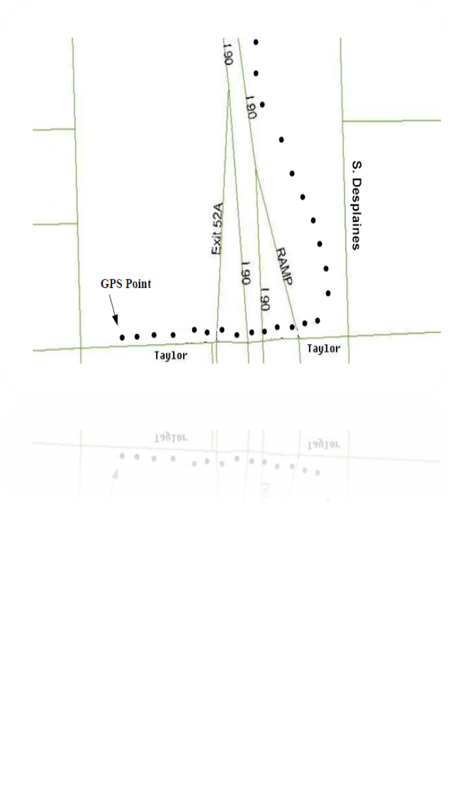
Map matching
The GPS probe data collected is mostly inaccurate and can be accounted to the noise and sparseness of the data, which paves way to the concept of map matching where in we try and map the individual probe data points to the closest link/segment which forms a part of the complete path. This process is termed as map-matching.
How do we achieve this?

Slide 6
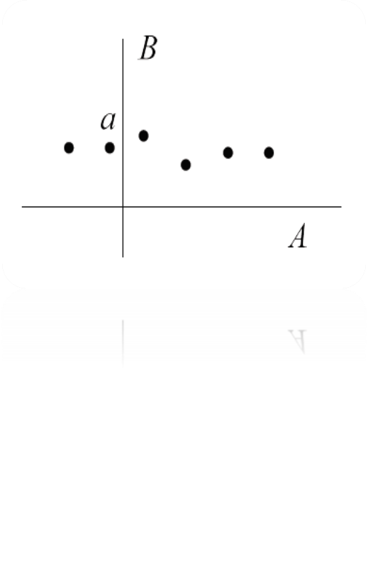
Map matching (continued..)
Global algorithms batch process the entire input trajectory before generating the solution.
Incremental/online algorithms employ localizing strategies that divide the input trajectory into smaller segments and process them sequentially, sometimes resulting in a suboptimal solution.
For each probe point compute the perpendicular intersection of the probe point’s projection onto each segment/link.

Slide 7
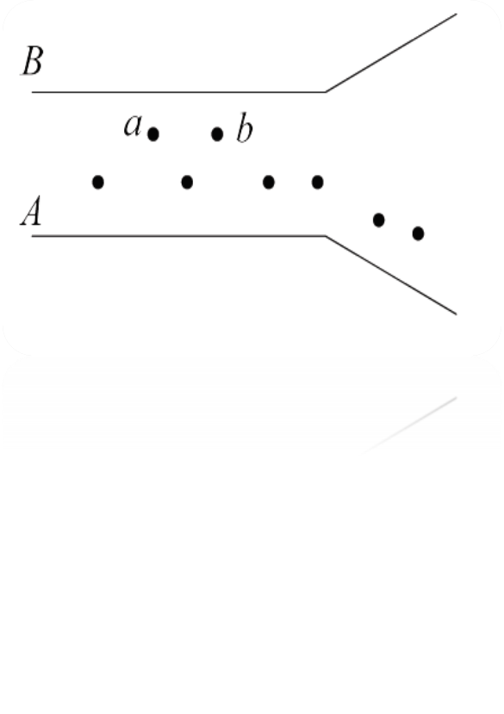
Map matching (continued..)
Now compute the distance so obtained for all the links with respect to each probe point’s coordinates.
Select the shortest distance and form pairs of such links and probe points.
At the end of this process we would end up obtaining dictionaries with link id as the key and probe point IDs as the values.
So the Map Matching comes to an end at this point in time.

Slide 8
Deducing the Slope
We have used the Haversine formula to determine the great circle distance between any two points on a sphere given their latitude and longitude.
For each set of probe points associated with a link, we compute the slope between each pair of points.

Slide 9
Deducing the slope
 |  | h1-h2 |  | α
 |  |  | h1 |  | h2
 |  |  |  | d
‘α’
Is the slope angle between the consecutive probe points paired with the link/segment.
We thus calculate the slopes between all the consecutive pairs of points and take an average of these values to obtain a consistent slope for a segment or link.
‘d’ is the haversine distance between p1 and p2 computed as shown in the following slide.
P2(x2,y2)
P1(x1,y1)

Slide 10
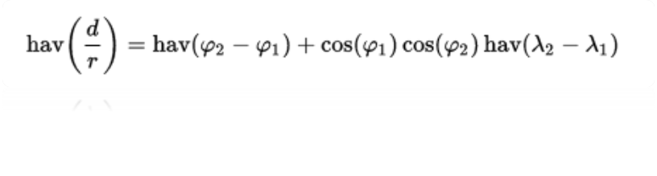
Haversine Formula
‘Haversine’ formula is used to calculate the great-circle distance between two points – that is, the shortest distance over the earth’s surface – giving an ‘as-the-crow-flies’ distance between the points.
Where,
φ is latitude,
λ is longitude,
note that angles need to be in radians to pass to trig functions!

Slide 11
Slope Computation
SLOPE = tan α = (Opp/Adj)
Where,
Opp = difference between the heights of the probe points P1 and P2 which can be computed using the data in the link segment csv file given.
Adj = haversine distance between he probe points under consideration.
Eventually an average of all the slopes corresponding to a link/segment is
computed which is treated as a generalized slope value.
These values are populated into a .csv file juxtaposing with the given
mean values of the slopes which can be observed in the attached
csv files.

Slide 12
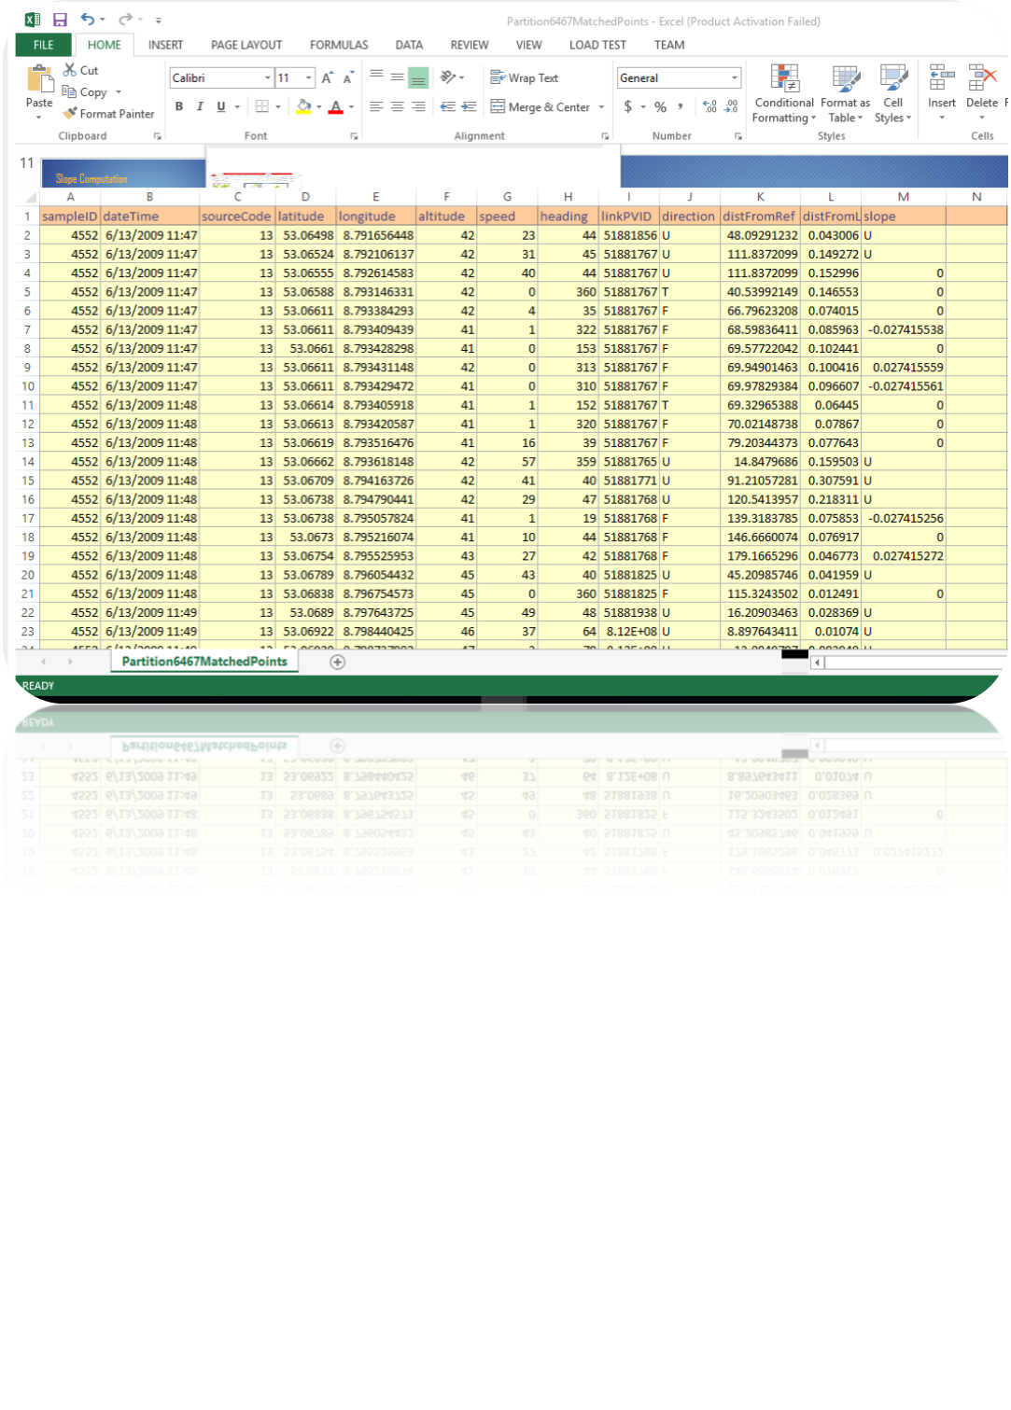
Output – Map matching

Slide 13
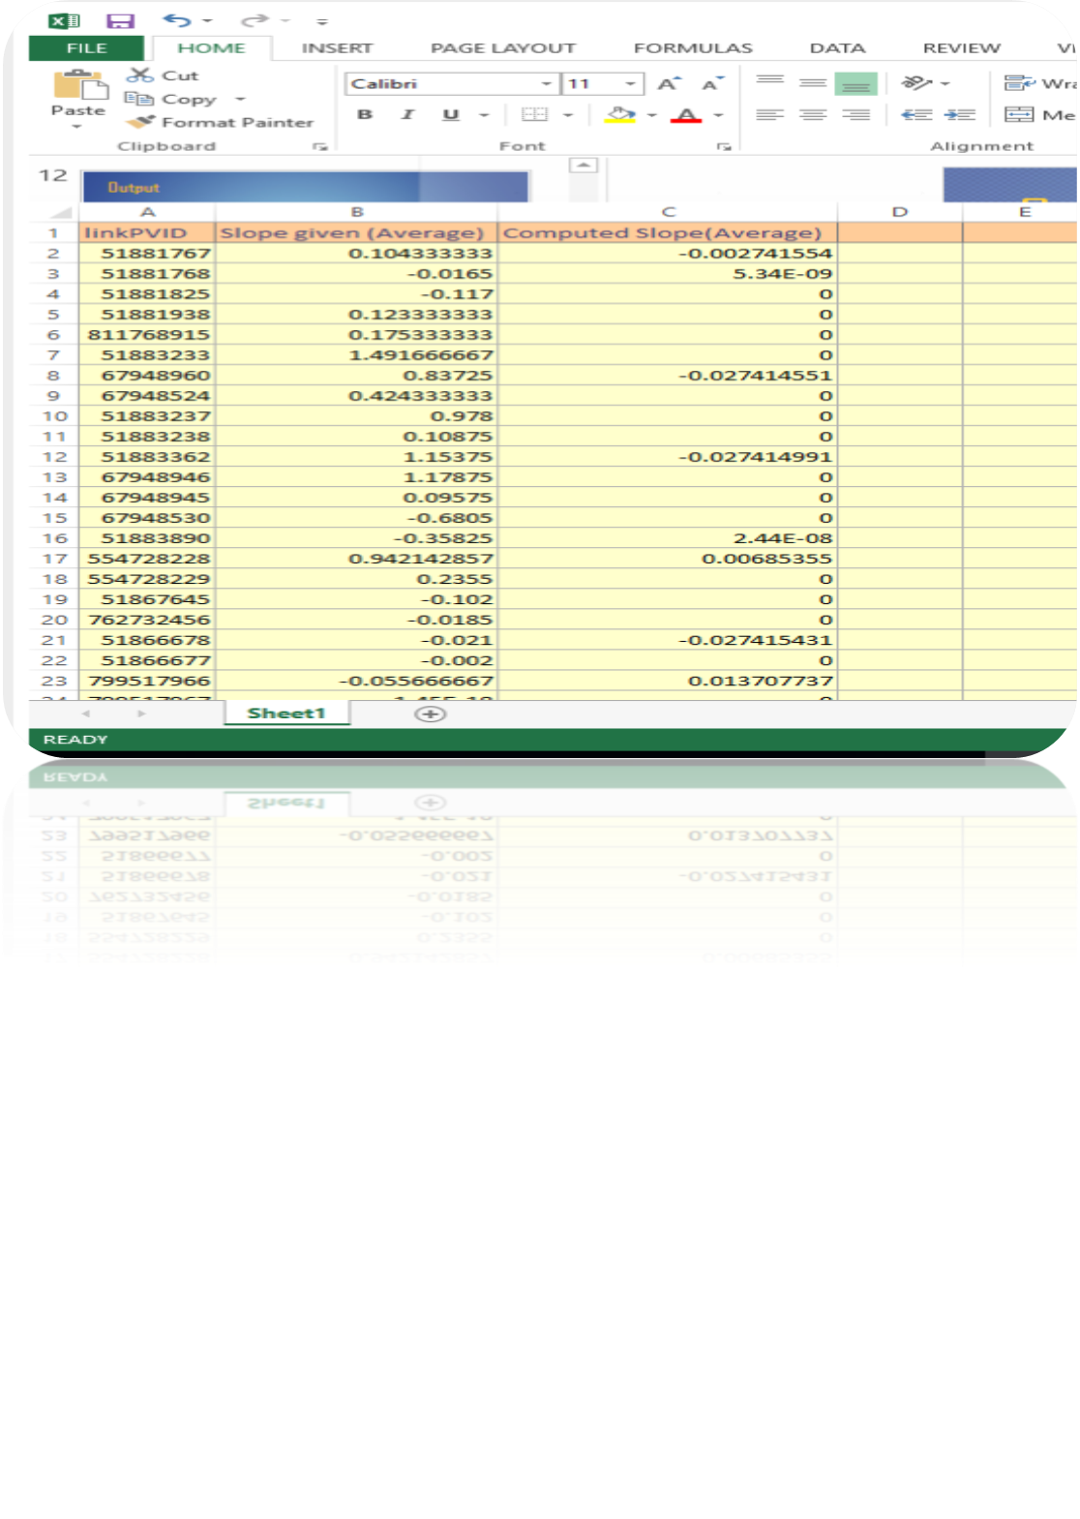
Output – Slope data

Slide 14
Conclusion
Highly precise GPS traces are rarely available.
Dense trajectories are costly for live transmission and storage.
For future work, we can explore the design of map-matching algorithms with dynamic parameters that detect and adapt to different environmental settings,
A better approximation of the actual traveled paths may improve map-matching accuracy.

Slide 15
References
Online map matching based on Hidden Markov model for real-time Traffic sensing Applications
http://web.mit.edu/jaillet/www/general/map_matching_itsc2012final.pdf
www.google.com
A Virtual differential Map Matching Algorithm with Improved Accuracy and Computational Efficiency
http://www.depts.ttu.edu/transtech/Paper/21.pdf
C. Jensen and N. Tradiauskas. Map Matching. Encyclopedia of Database Systems, 2009, pp. 1692-1696.
Map matching for Low-Sampling Rate GPS Trajectories
http://research.microsoft.com/apps/pubs/default.aspx?id=105051
An Interactive Voting based Map Matching Algorithm
http://research.microsoft.com/apps/pubs/?id=121065.
Guest Lecture by Dr. Bo Xu

